Slide 1

Trading Team 2
Ben Belke, William Ho, Kai

Slide 2
SUMMARY
Initial step
Set up GitHub
Research on Range trading
Mid Term
Visualise different indicators
Dive into machine learning
Explore linear regression and KNN
Final step
Machine learning model failed
Retreat to backup traditional trading model

Slide 3
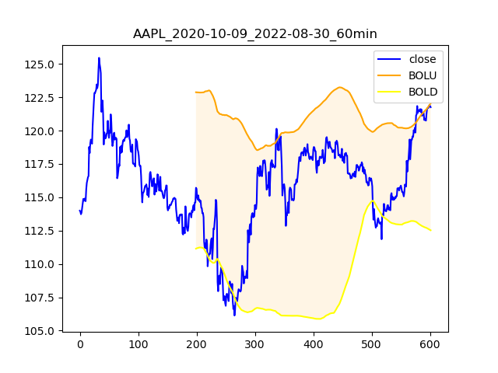
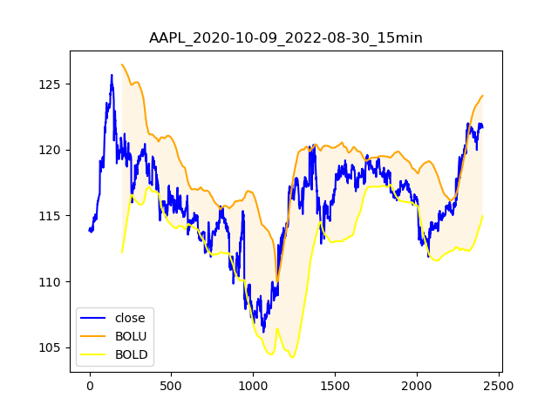
Volatility in different intervals
Shorter intervals => Larger volatility!

Slide 4
Larry Connors’ %b Strategy
Strategy
The close must be above the 200-day moving average.
The %b must be below 0 for the last two or three (consecutive) days.
If 1 and 2 are true, buy on the close.
Exit when the %b closes above 0.8.
Reasons:
Safety measurements (Only trade long, reduce short risk)
Decent entry and closing consideration

Slide 5
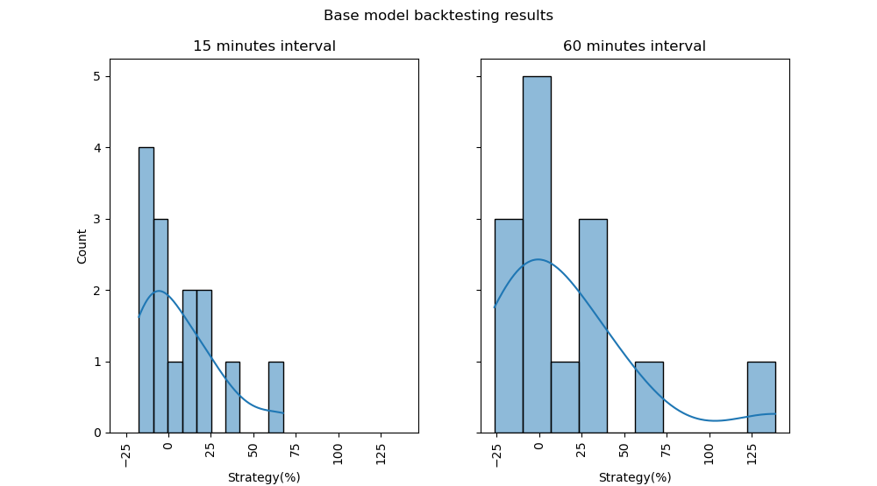
Back-test base model
Observations:
Most Stocks sits between ± 25 %
60 mins interval has an exceptional trade

Slide 6
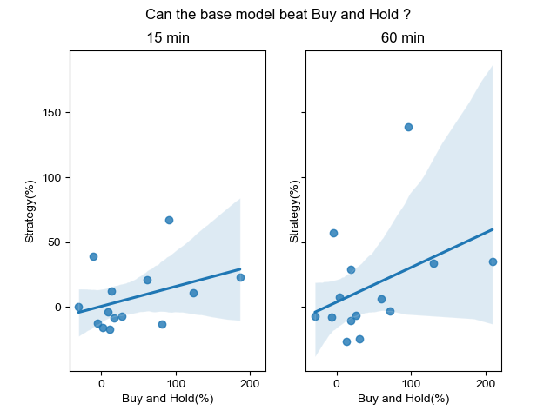
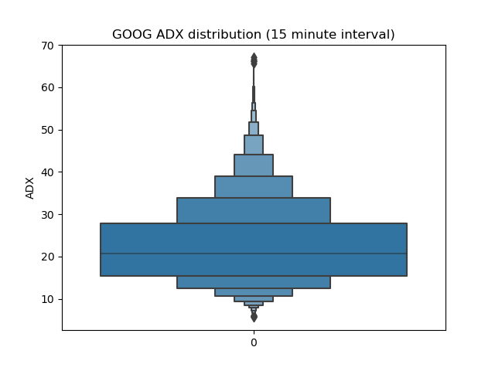
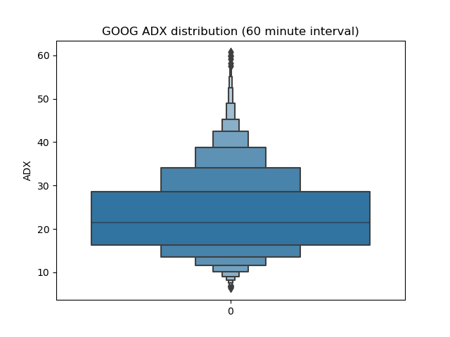
Implement range trading
Set 20 as the threshold for ranging markets (ADX < 20)

Slide 7
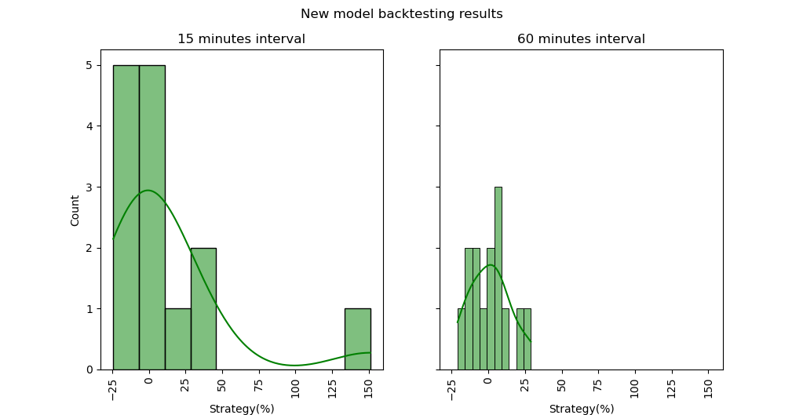
Back-test new model
Observations:
60 mins interval behave strangely
15 mins interval has an exceptional trade

Slide 8
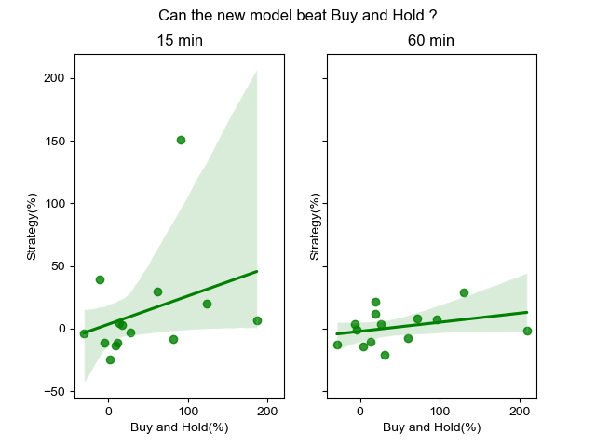
Initial-Comparison
Observations:
Most stocks sits between ± 25 %
Stocks that profits in 15 mins in the new model profits more than the old model
(Most importantly) Neither of them beats Buy and Hold!

Slide 9
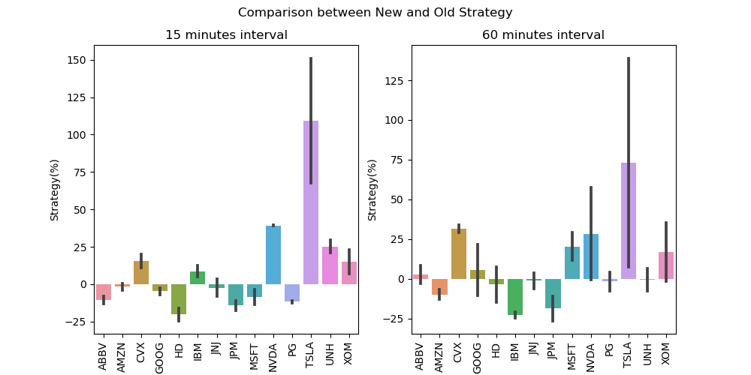
Profit

Slide 10
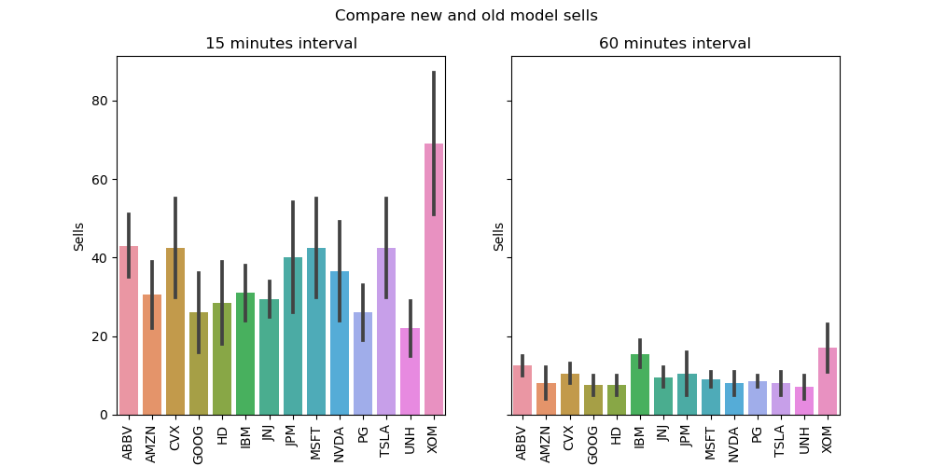
Sells

Slide 11
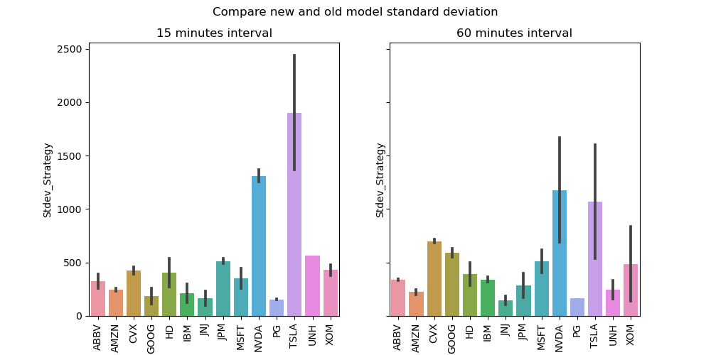
Standard-Deviation

Slide 12
Overall
Median
 | OLD | NEW
15 min | -1.495 | 0.275
60 min | 1.815 | 1.495

Slide 13
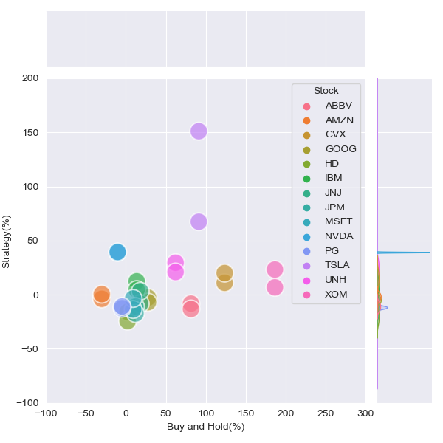
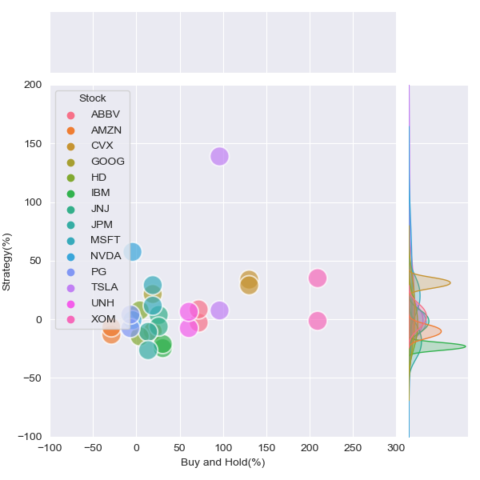
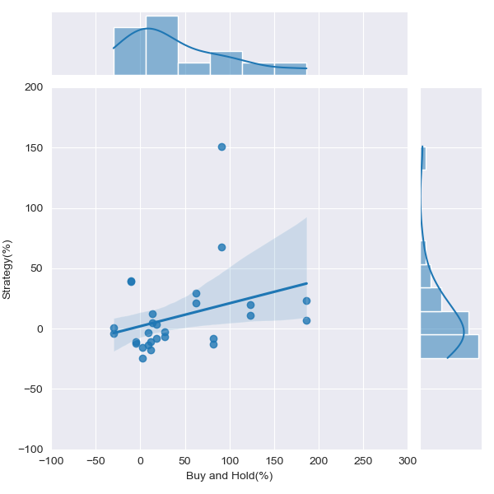
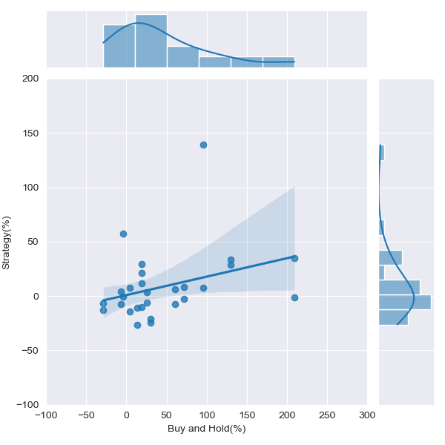
Compare both with Buy and Hold
15 mins
60 mins

Slide 14
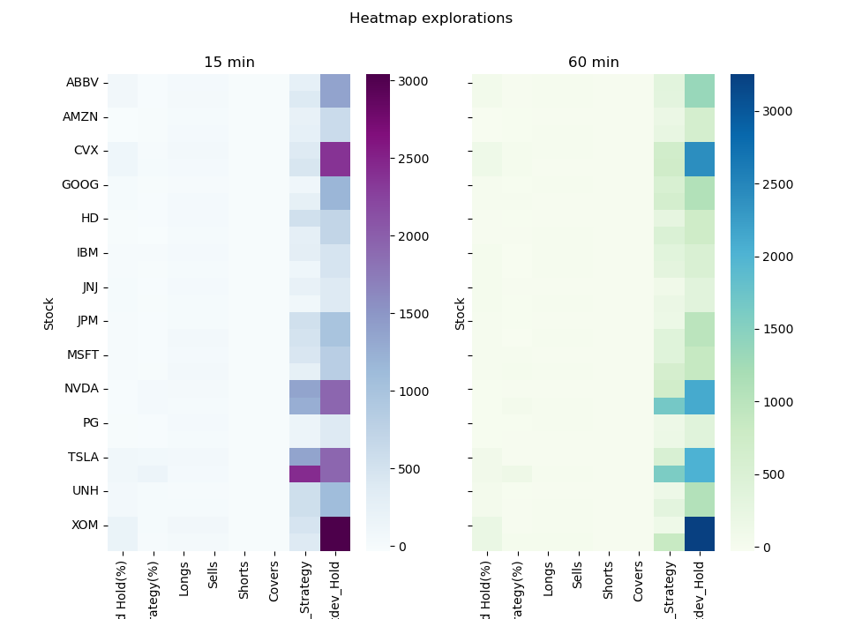
Future-exploration

Slide 15
Limitations/Challenges
Crashes/Algorithm running time
Using backup model since previous machine learning model failed (Time limitations)

